Slide 1


IT496: Introduction to Data Mining
Ensemble Methods (Bagging, Boosting, Stacking ..)
Himanshu Beniwal
06th Oct 2023

Slide 2
Ensemble Methods
Bagging: It is a homogeneous weak learners’ model that learns from each other independently in parallel and combines them for determining the model average.
Boosting: It is also a homogeneous weak learners’ model but works differently from Bagging. In this model, learners learn sequentially and adaptively to improve model predictions of a learning algorithm.

Slide 3
Bagging (Random Forest)
It is an ensemble machine learning algorithm called Bootstrap Aggregation or bagging.
The bootstrap is a powerful statistical method for estimating a quantity from a data sample. This is easiest to understand if the quantity is a descriptive statistic such as a mean or a standard deviation.
Example
Sample of 100 values (x) and we’d like to get an estimate of the mean of the sample.
mean(x) = 1/100 * sum(x)

Slide 4
Bagging (Random Forest)
It is an ensemble machine learning algorithm called Bootstrap Aggregation or bagging.
The bootstrap is a powerful statistical method for estimating a quantity from a data sample. This is easiest to understand if the quantity is a descriptive statistic such as a mean or a standard deviation.
Example
Sample of 100 values (x) and we’d like to get an estimate of the mean of the sample.
mean(x) = 1/100 * sum(x)
[bootstrap]
Create many (e.g. 1000) random sub-samples of our dataset with replacement (meaning we can select the same value multiple times).
Calculate the mean of each sub-sample.
Calculate the average of all of our collected means and use that as our estimated mean for the data.
For example, let’s say we used 3 resamples and got the mean values 2.3, 4.5 and 3.3. Taking the average of these we could take the estimated mean of the data to be 3.367.

Slide 5
Bagging
Ensemble meta-algorithm to improve the stability and accuracy used in statistical classification and regression.
It decreases the variance and helps to avoid overfitting.
It is usually applied to decision tree methods.
Bagging is a special case of the model averaging approach.

Slide 6
Bagging
Ensemble meta-algorithm to improve the stability and accuracy used in statistical classification and regression.
It decreases the variance and helps to avoid overfitting.
It is usually applied to decision tree methods.
Bagging is a special case of the model averaging approach.
Suppose a set D of d tuples, at each iteration i, a training set Di of d tuples is selected via row sampling with a replacement method (i.e., there can be repetitive elements from different d tuples) from D (i.e., bootstrap). Then a classifier model Mi is learned for each training set D < i. Each classifier Mi returns its class prediction. The bagged classifier M* counts the votes and assigns the class with the most votes to X (unknown sample).

Slide 7
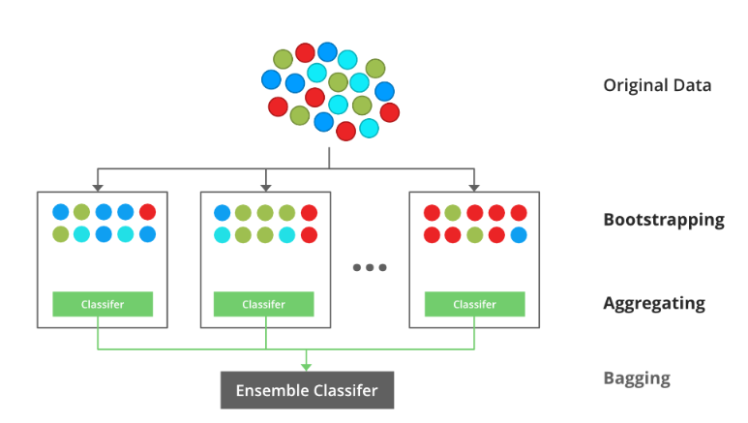
Bagging (Implementation)
Step 1: Multiple subsets are created from the original data set with equal tuples, selecting observations with replacement.
Step 2: A base model is created on each of these subsets.
Step 3: Each model is learned in parallel with each training set and independent of each other.
Step 4: The final predictions are determined by combining the predictions from all the models.
Source: Geeksforgeeks

Slide 8
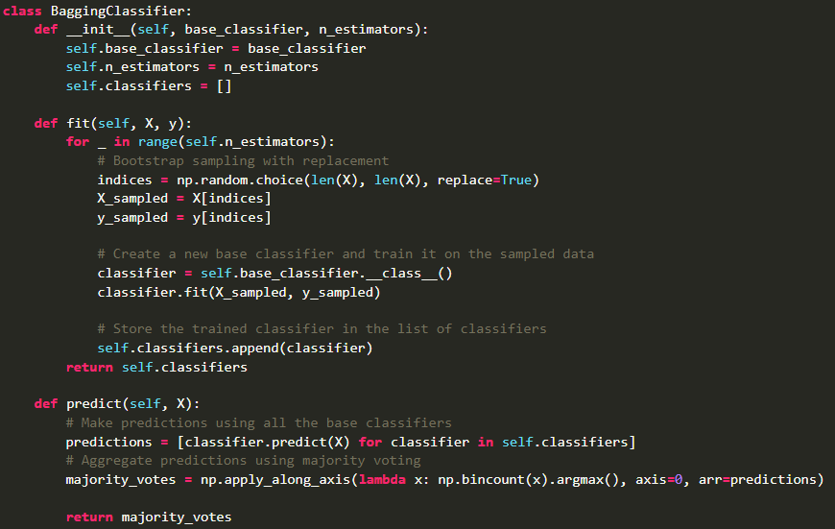
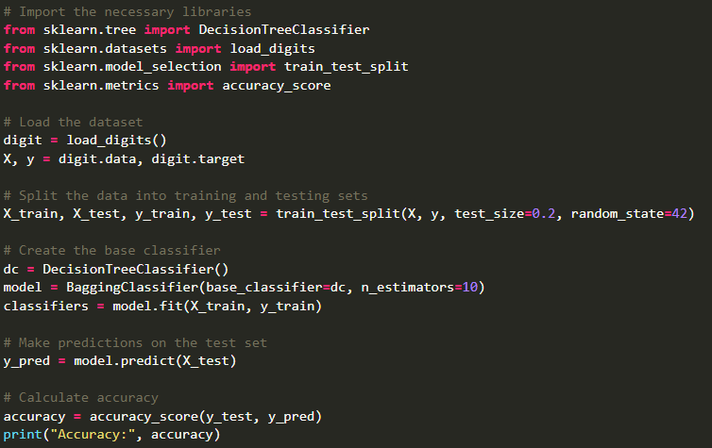
Bagging (Implementation)
Source: Geeksforgeeks

Slide 9
Bagging (Advantages)
Improved Predictive Performance: Often outperforms single classifiers by reducing overfitting and increasing predictive accuracy. By combining multiple base models, it can better generalize to unseen data.

Slide 10
Bagging (Advantages)
Improved Predictive Performance: Often outperforms single classifiers by reducing overfitting and increasing predictive accuracy. By combining multiple base models, it can better generalize to unseen data.
Robustness: Bagging reduces the impact of outliers and noise in the data by aggregating predictions from multiple models. This enhances the overall stability and robustness of the model.

Slide 11
Bagging (Advantages)
Improved Predictive Performance: Often outperforms single classifiers by reducing overfitting and increasing predictive accuracy. By combining multiple base models, it can better generalize to unseen data.
Robustness: Bagging reduces the impact of outliers and noise in the data by aggregating predictions from multiple models. This enhances the overall stability and robustness of the model.
Reduced Variance: Since each base model is trained on different subsets of the data, the aggregated model’s variance is significantly reduced compared to an individual model.

Slide 12
Bagging (Advantages)
Improved Predictive Performance: Often outperforms single classifiers by reducing overfitting and increasing predictive accuracy. By combining multiple base models, it can better generalize to unseen data.
Robustness: Bagging reduces the impact of outliers and noise in the data by aggregating predictions from multiple models. This enhances the overall stability and robustness of the model.
Reduced Variance: Since each base model is trained on different subsets of the data, the aggregated model’s variance is significantly reduced compared to an individual model.
Parallelization: Bagging allows for parallel processing, as each base model can be trained independently. This makes it computationally efficient, especially for large datasets.

Slide 13
Bagging (Advantages)
Improved Predictive Performance: Often outperforms single classifiers by reducing overfitting and increasing predictive accuracy. By combining multiple base models, it can better generalize to unseen data.
Robustness: Bagging reduces the impact of outliers and noise in the data by aggregating predictions from multiple models. This enhances the overall stability and robustness of the model.
Reduced Variance: Since each base model is trained on different subsets of the data, the aggregated model’s variance is significantly reduced compared to an individual model.
Parallelization: Bagging allows for parallel processing, as each base model can be trained independently. This makes it computationally efficient, especially for large datasets.
Flexibility: Bagging Classifier is a versatile technique that can be applied to a wide range of machine learning algorithms, including decision trees, random forests, and support vector machines.

Slide 14
Bagging (Applications)
Fraud Detection: Bagging Classifier can be used to detect fraudulent transactions by aggregating predictions from multiple fraud detection models.

Slide 15
Bagging (Applications)
Fraud Detection: Bagging Classifier can be used to detect fraudulent transactions by aggregating predictions from multiple fraud detection models.
Spam filtering: Bagging classifier can be used to filter spam emails by aggregating predictions from multiple spam filters trained on different subsets of the spam emails.

Slide 16
Bagging (Applications)
Fraud Detection: Bagging Classifier can be used to detect fraudulent transactions by aggregating predictions from multiple fraud detection models.
Spam filtering: Bagging classifier can be used to filter spam emails by aggregating predictions from multiple spam filters trained on different subsets of the spam emails.
Credit scoring: Bagging classifier can be used to improve the accuracy of credit scoring models by combining the predictions of multiple models trained on different subsets of the credit data.

Slide 17
Bagging (Applications)
Fraud Detection: Bagging Classifier can be used to detect fraudulent transactions by aggregating predictions from multiple fraud detection models.
Spam filtering: Bagging classifier can be used to filter spam emails by aggregating predictions from multiple spam filters trained on different subsets of the spam emails.
Credit scoring: Bagging classifier can be used to improve the accuracy of credit scoring models by combining the predictions of multiple models trained on different subsets of the credit data.
Image Classification: Bagging classifier can be used to improve the accuracy of image classification tasks by combining the predictions of multiple classifiers trained on different subsets of the training images.

Slide 18
Bagging (Applications)
Fraud Detection: Bagging Classifier can be used to detect fraudulent transactions by aggregating predictions from multiple fraud detection models.
Spam filtering: Bagging classifier can be used to filter spam emails by aggregating predictions from multiple spam filters trained on different subsets of the spam emails.
Credit scoring: Bagging classifier can be used to improve the accuracy of credit scoring models by combining the predictions of multiple models trained on different subsets of the credit data.
Image Classification: Bagging classifier can be used to improve the accuracy of image classification tasks by combining the predictions of multiple classifiers trained on different subsets of the training images.
Natural language processing: In NLP tasks, the bagging classifier can combine predictions from multiple language models to achieve better text classification results.

Slide 19
2. Boosting
Attempts to build a strong classifier from the number of weak classifiers. It is done by building a model by using weak models in series.
Firstly, a model is built from the training data. Then the second model is built which tries to correct the errors present in the first model.
This procedure is continued and models are added until either the complete training data set is predicted correctly or the maximum number of models is added.

Slide 20
2. Boosting (Similarities)
Both are ensemble methods to get N learners from 1 learner.
Both generate several training data sets by random sampling.
Both make the final decision by averaging the N learners (or taking the majority of them i.e Majority Voting).
Both are good at reducing variance and provide higher stability.

Slide 21
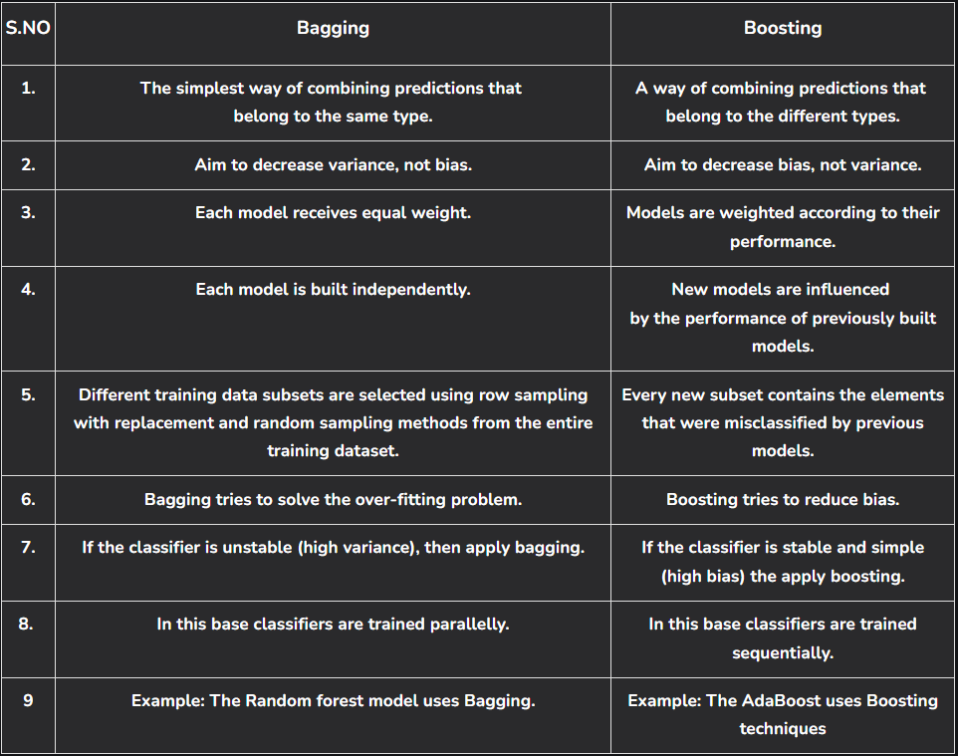
2. Boosting (Differences)

Slide 22
IT496: Introduction to Data Mining
That’s all! :)
Colab link ⬅️

